Slide 1
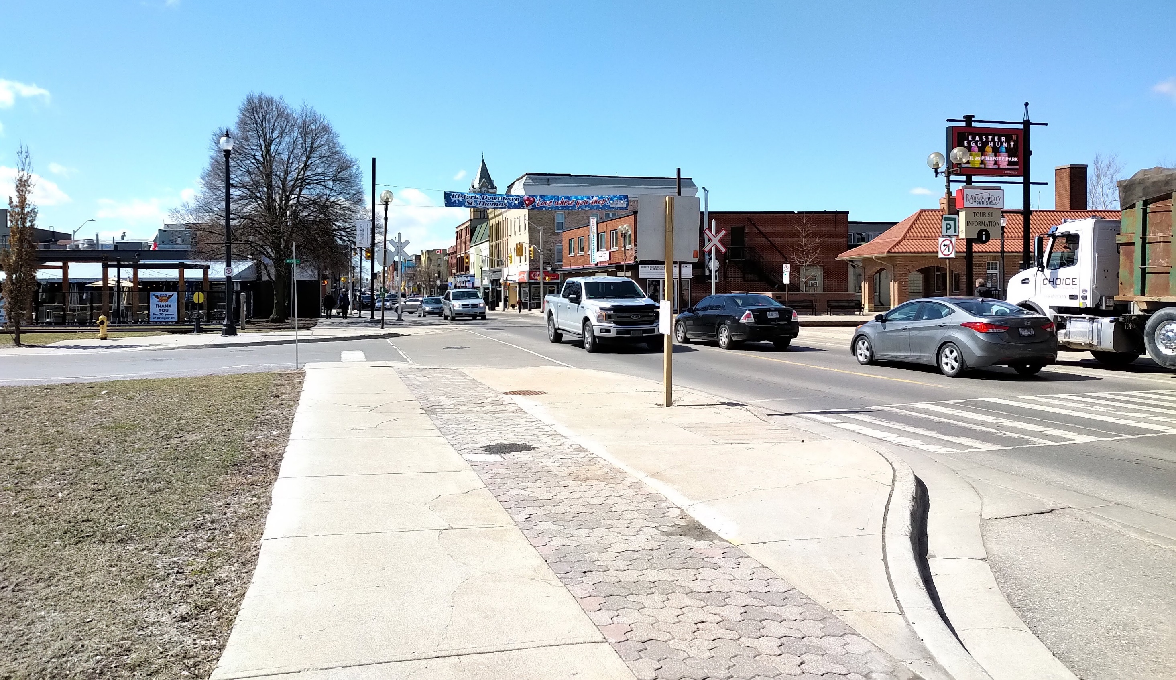
City of St. Thomas
Multi-Modal Transportation Master Plan Update
Virtual Public Consultation Meeting
September 9, 2020

Slide 2
First Things First…
Presentation by the Project Team
Question and Answer Period – “Raise your Hand” or Dial “9”
Presentation, Transcript, and Question and Answer Summary will be available at www.stthomas.ca/TMP following the meeting
Please provide any comment on this first phase of the study by October 2, 2020

Slide 3
Why are we here?
Overview of the TMP Update Process
Current conditions and future directions
We want your input on:
Existing transportation network
Areas of opportunity
Other considerations

Slide 4
The Process…
Long range strategic plan to 2041
Provide connectivity between transportation modes
Promote a sustainable transportation system that promotes walking, cycling, transit
Define policies and strategies to protect transportation corridors for all modes
Phase 1
Phase 2
Phase 3
Phase 4
Here
Spring
2021
Background Context/
Existing Conditions
Future Needs and Opportunities
Assessment of Alternatives and Preferred Solutions
Implementation/
Costing

Slide 5
The Community
Changing demographics and development patterns will impact the City’s transportation network
Forecasted Dwelling Distribution 2020-2030
St. Thomas Development Charge Background Study (2020 – DRAFT)
St. Thomas Community Profile
Stats Canada, 2016 Census Data

Slide 6
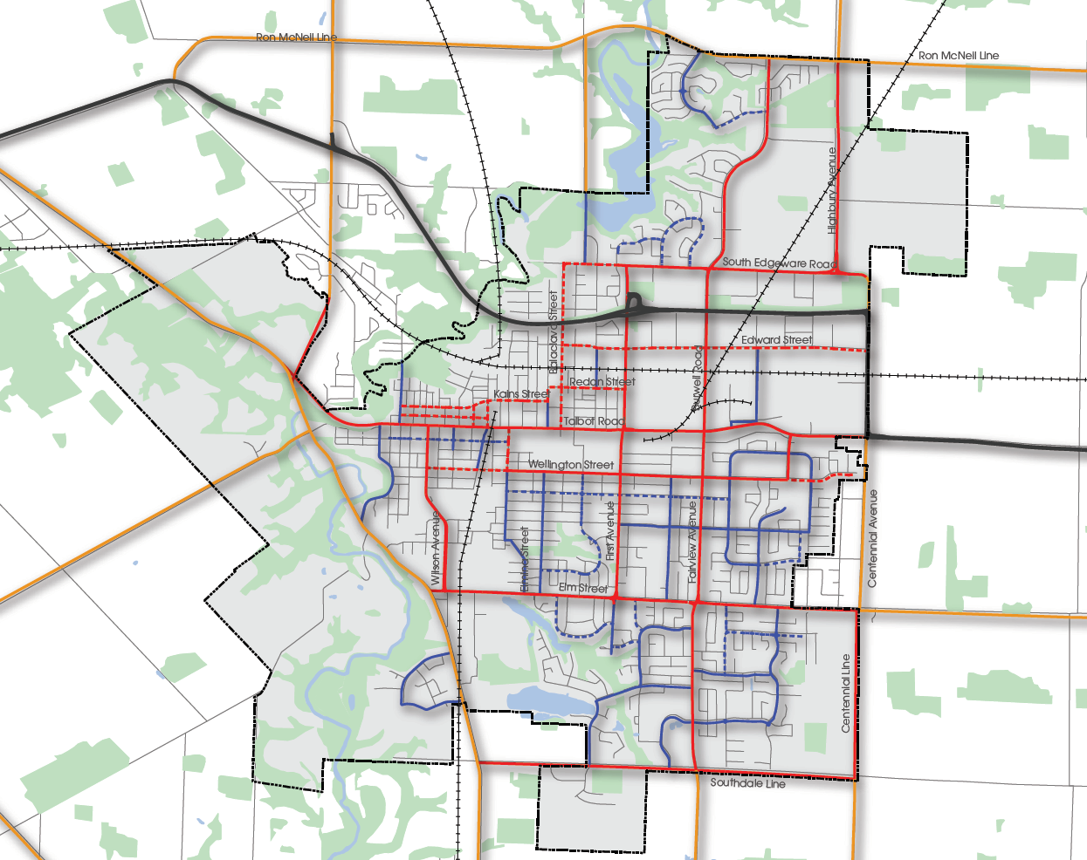
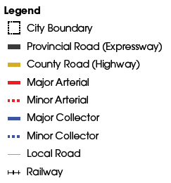
The Network – Road Classifications
Provincial Highways
Arterial Roads/County Roads
Collector Roads
Local Roads
6

Slide 7
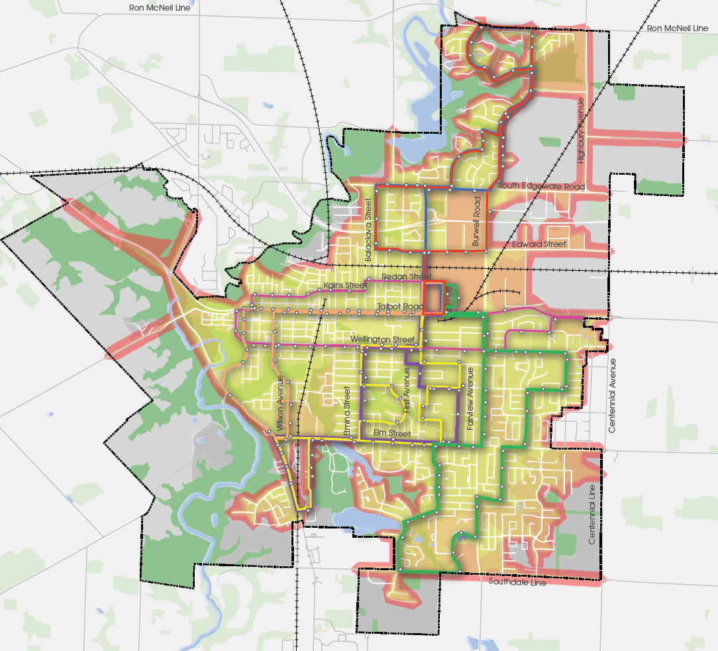
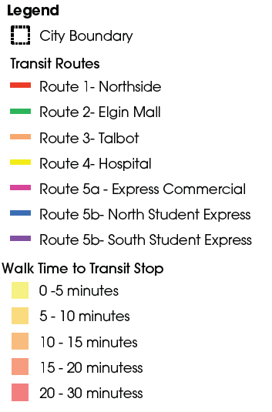
The Network - Transit
St. Thomas Transit Strategic Plan (2019) recommendations include:
Higher frequency service along Talbot Street
Conversion of low-ridership areas into on-demand service areas
Later evening service via on-demand
Reduced frequency on lower-tier routes to allow for Sunday service pilot project

Slide 8
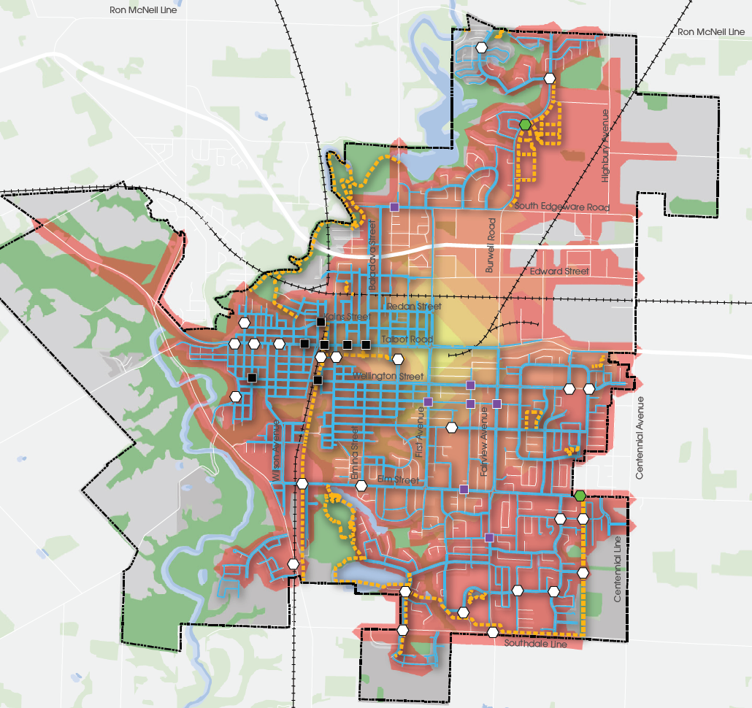
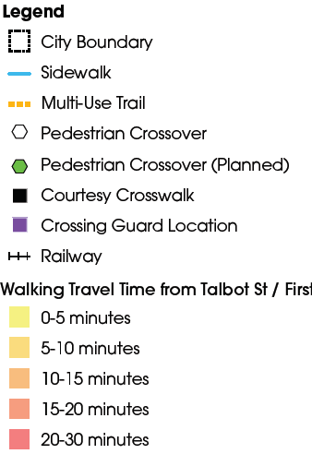
Current Gaps in the Pedestrian Network
The Network - Walking
234 kms of sidewalks and multi-use pathways
40 signalized intersections, 27 pedestrian crossovers, and 7 courtesy crosswalks.

Slide 9
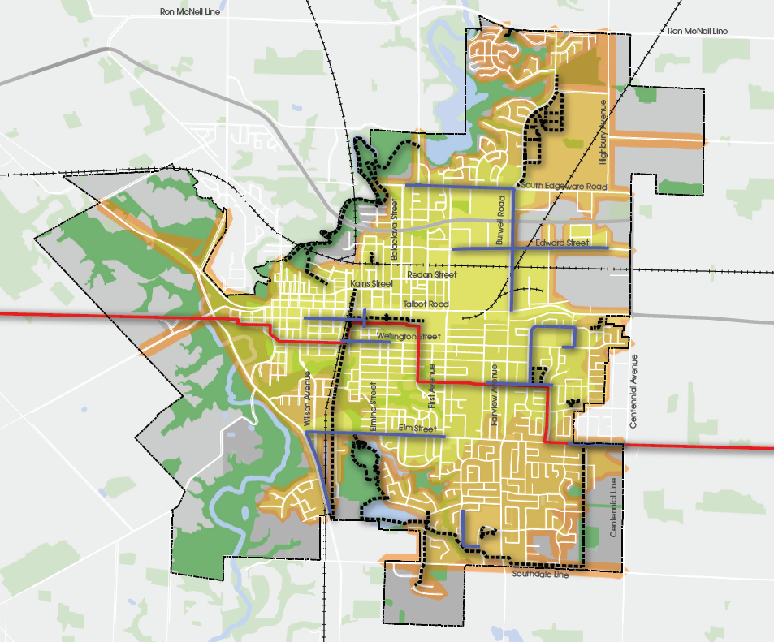
The Network - Cycling
St. Thomas has approximately 52km of cycling infrastructure (bike lanes, multi-use pathways, and trails)
Current gaps in the network:
Residential/Institutional areas around Fairview Street
Balaclava Street area north of Talbot
The entire built area of the City can access the downtown core within a 15 min bike ride
Current Gaps in the Cycling Network
9

Slide 10
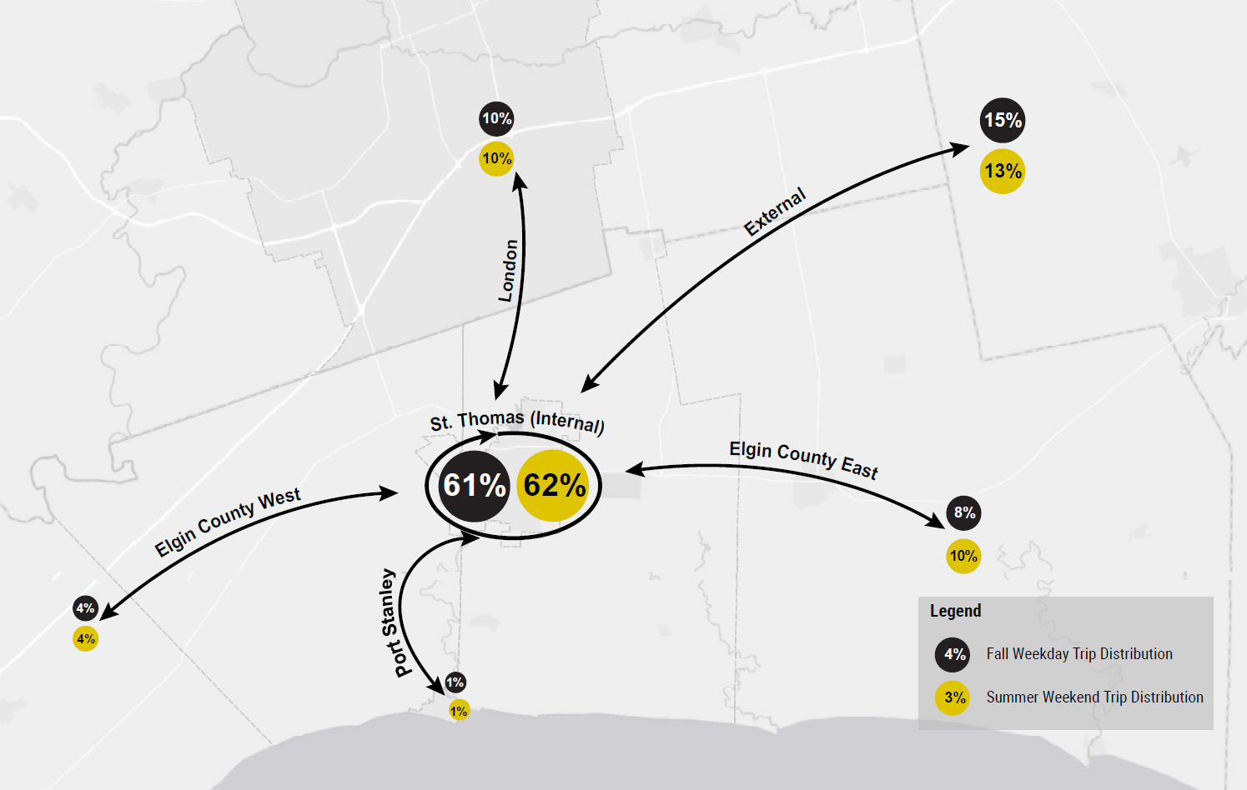
Trip Distribution
Fall Weekday and Summer Weekend represent peak travel times
Over 60% of trips stay internal to St. Thomas
Fairly equal trips between Elgin County East, Port Stanley, City of London, and External Areas
Smaller proportion heading to Elgin County West areas
10

Slide 11
Mode Share and Trip Length
95% of trips in St. Thomas are made by car
Over 80% of trips by car are less than 6 Kms
11
Weekday Trip Length in St. Thomas

Slide 12
Vision and Objectives
“Multi-Modal Transportation Network that facilitates connectivity for residents to jobs, services, and recreation, providing options for traveling within and beyond the City safely and efficiently.”
Provide infrastructure for growth | Plan flexible infrastructure for Seasonal Changes | Prioritize and encourage active transportation
Prioritize and encourage Transit | Improve safety for all road users | Enhance multi-modal connections
12

Slide 13
Next Steps
Public Consultation Meeting #2
Review and consider feedback from the Online Survey and Public Meetings
Prepare traffic forecasting and modeling to understand future needs and opportunities
Identify and assess alternative solutions
Another Public Consultation Meeting will be held during Phase 3 (winter, 2020)
Phase 1
Phase 2
Phase 3
Phase 4
Spring
2021
Background Context/
Existing Conditions
Future Needs and Opportunities
Assessment of Alternatives and Preferred Solutions
Implementation/
Costing

Slide 14
Questions?
Nathan Bokma, P. Eng.
Manager of Development and Compliance
City of St. Thomas
519-631-1680 Ext. 4151
nbokma@stthomas.ca
Feel free to “raise your hand” to ask a question or submit your comments via email or phone to a member of the project team
This presentation along with transcript and Question and Answer Summary will be posted on www.stthomas.ca/tmp following the presentation
Brandon Orr, MCIP, RPP
Project Manager
Stantec Consulting Ltd.
416-507-3487
Brandon.orr@stantec.com

Slide 15
Let’s Talk!
What do you like about the City’s Transportation Network?
What influences your decision to drive/walk/cycle/take transit the most?
What do you think could be improved?
What do you think will be our greatest transportation challenge over the next 20 years?
Notes:
We’d love to hear your thoughts on the current transportation network, including areas you think could be improved. We’re also interested in hearing about what types of factors influence your transportation choices the most, and what you see as our greatest challenges over the next 20 years. Once you raise your hand, we will unmute your microphone so that you can speak with the project team.

